Slide 1
EdgeX Overview

Slide 2
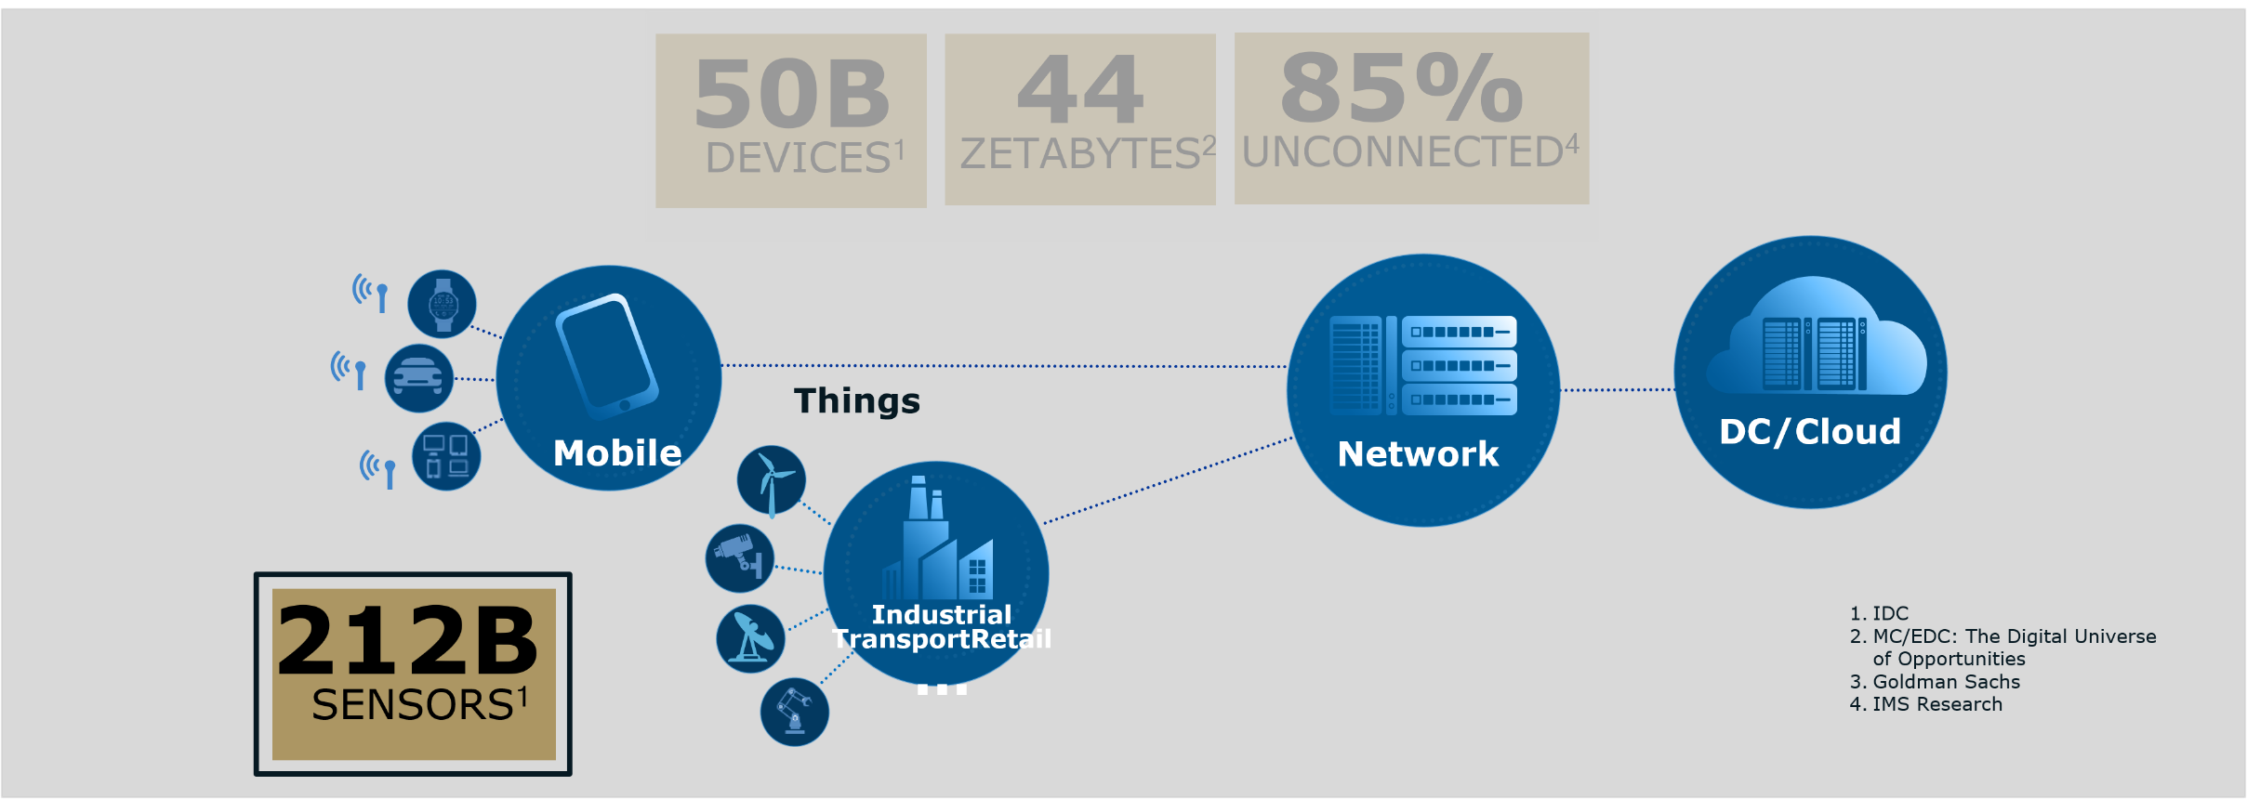
IoT is Moving to the Edge
Many IoT deployments face challenges related to latency, network bandwidth, reliability and security, which cannot be addressed in cloud-only models‘
Source: OpenFoG Consortium

Slide 3
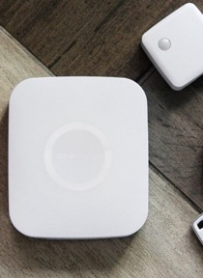


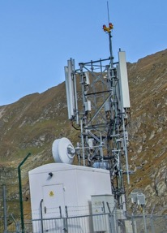
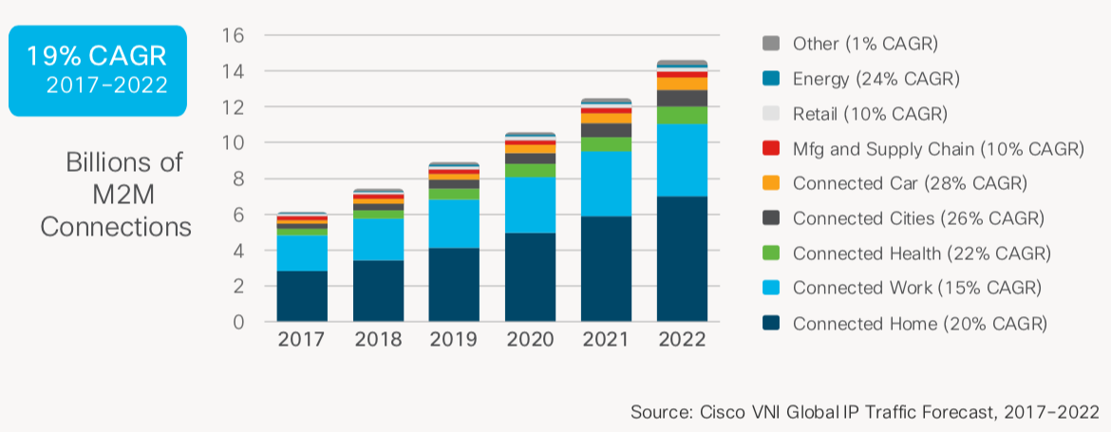
IOT Edge Markets
Industrial and Enterprise use cases in complex
environments at the Edge Targets:
Industrial Manufacturing
Energy (Oil & Gas, Utilities)
Commerce
Fleet/Transportation
Logistics
Building Automation
Cities and Government
Healthcare

Slide 4
Why is IoT at the Edge Hard to do?
Heterogeneity of platforms
Diverse collection of OS and OS variants
Linux, Unix, Windows, VxWorks, embedded and RTOS, …
Various Hardware (Intel, AMD, ARM,…)
Cloud, gateway, smart thing (the “Fog continuum”)
Thing protocol soup
Industrial: BACNet, Modbus, OPC-UA,…
Wireless: BLE, Z-Wave, Zigbee,…
Message: MQTT, AMQP, DDS, …
Variety of cloud platforms
Azure IoT Hub, AWS IoT Platform, Google IoT Core, IBM Watson IoT Platform, …
Add your favorite selection of…
Applications, edge analytics/intelligence, security, system management, …
Difficulties in determining where to start
Notes:
https://www.postscapes.com/internet-of-things-protocols/

Slide 5
Introducing EdgeX
July 2019

Slide 6
IoT Architecture
IoT Architecture

Slide 7
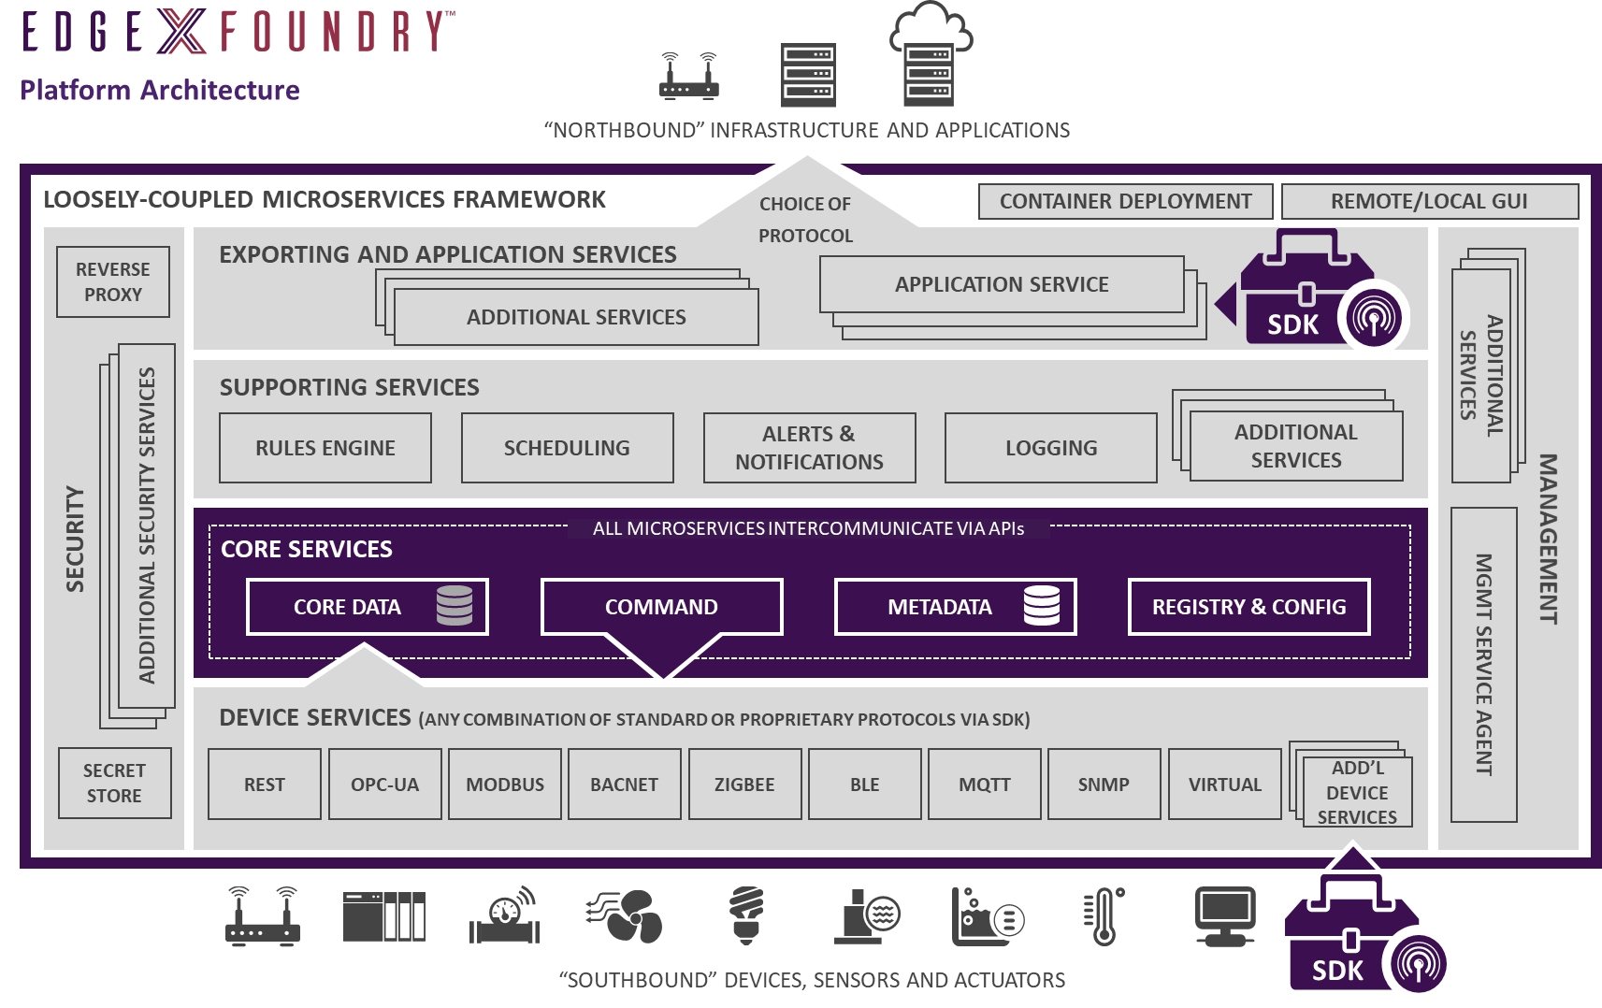

Slide 8
EdgeX Primer - How it Works
A collection of a dozen+ micro services
Written in multiple languages (Java, Go, C, … we are polyglot believers!!)
EdgeX data flow:
Sensor data is collected by a Device Service from a thing
Data is passed to the Core Services for local persistence
Data is then passed to Export Services for transformation, formatting, filtering and can then be sent “north” to enterprise/cloud systems
Export Services are being replaced by Application Services in the EdgeX Fuji release.
Improved capability, more flexibility and more scalability.
Data is then available for edge analysis and can trigger device actuation through Command service
Many other services provide the supporting capability that drives this flow
REST communications between the service
Some services exchange data via message bus (core data to export services and rules engine)
Micro services are deployed via Docker and Docker Compose

Slide 9
Introducing EdgeX Foundry
The World’s first plug and play Ecosystem enabled Open platform for the IOT Edge
EdgeX FoundryTM is a vendor-neutral open source project hosted by The Linux Foundation building a common open Platform for IoT edge computing.
At the heart of the project is an interoperability framework hosted within a full silicon-hardware-OS-cloud agnostic reference software platform to enable an ecosystem of plug-and-play components that unifies the marketplace and accelerates the deployment of IoT solutions.
Speeds time to market by providing replaceable reference services for device-data ingestion, normalization, analysis and sharing in support of new IoT data services and advanced edge computing applications.
Commercial Developers, technology providers and end users can realize business-value faster at a lower cost and risk level through the skills, resource sharing and economies of scale of the EdgeX ecosystem, either for their own implementations of offering commercial “EdgeX-ready” offerings to others.
As such, EdgeX is a key enabler of digital transformation for IoT use cases and businesses in all vertical markets. An open source, vendor neutral project and ecosystem

Slide 10
EdgeX Foundry Goals
To build and deploy the pervasive open source Edge platform for the Internet of Things that helps drive innovation, global market adoption, velocity and scale
Build and promote EdgeX as the common open platform unifying edge computing
Enable and encourage a rapidly growing global ecosystem of IoT solutions providers to create a rich set of interoperable plug-and-play components
Certify EdgeX components to ensure interoperability and compatibility
Provide tools to quickly create EdgeX-based IoT edge solutions
Collaborate with relevant open source projects, standards groups, and industry alliances to ensure consistency and interoperability across the IoT

Slide 11
EdgeX Edinburgh Performance

Slide 12
EdgeX Scope
Through Community Extensions
EdgeX Open Source Baseline
Time Critical
Soft Real Time (“Relevant Time”)
Response Time
OS
Example Use Cases
High bandwidth, QoS, sub-millisecond, deterministic
RTOS
Milliseconds+
Traditional Linux or Windows
Smart Building, Energy Management, Factory Optimization, Predictive Maintenance, Quality Control, Supply Chain Management, Remote Asset Management, Fleet Management, Logistics, Environmental Monitoring
High-speed Process Control, Robotics, Safety Systems, Autonomous Vehicles

Slide 13
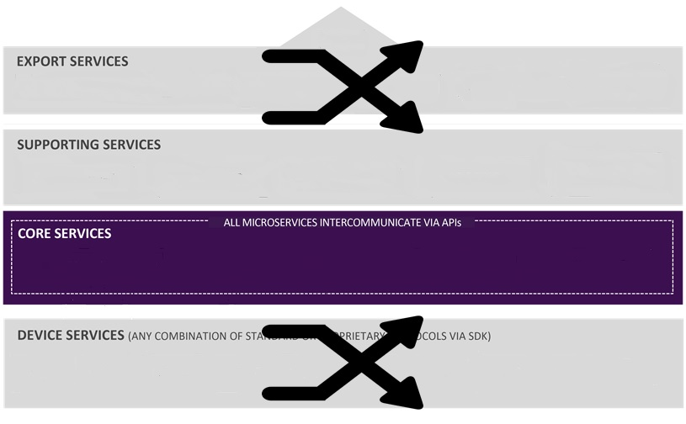
EdgeX Micro Service Layers
Contextually, EdgeX micro services are divided into 4 layers
Crudely speaking, the layers of EdgeX provide a dual transformation engine
1x - Translating information coming from sensors and devices via hundreds of protocols and thousands of formats into EdgeX
2x - Delivering data to applications, enterprises and cloud systems over TCP/IP based protocols in formats and structures of customer choice
“North side”
“South side”

Slide 14
EdgeX Enables Tiered Deployments
In today’s IoT landscape, it is imperative to leverage compute, storage, network resources where every they live
Loosely-coupled architecture enables distribution across nodes to enable tiered edge/fog computing
Scope includes embedded sensors to controllers, edge gateways and servers
Quantity and function of micro services deployed on a given node depends on the use case and capability of hardware

Slide 15

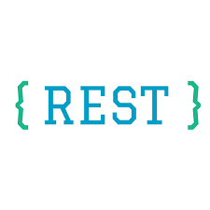



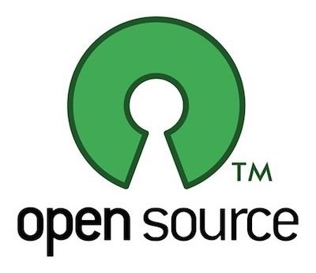
EdgeX Technology
A majority of the micro services are written in Go Lang
Previously written in Java
Some Device Services written in C/C++
A user interface is provided in JavaScript
Polyglot belief – use the language and tools that make sense for each service
Each service has a REST API for communicating with it
Uses MongoDB or Redis (user’s choice) to persist sensor data at the edge
Also stores application relevant information
Allows for alternate persistence storage (and has been done in the past)
A message pipe connects Core Data to Export Services and/or Rules Engine
Uses ZeroMQ by default
Allow use of MQTT as alternate if broker is provided
Uses open source technology where appropriate
Ex: Consul for configuration/registry, Kong for reverse proxy, Drools for rules engine,…

Slide 16
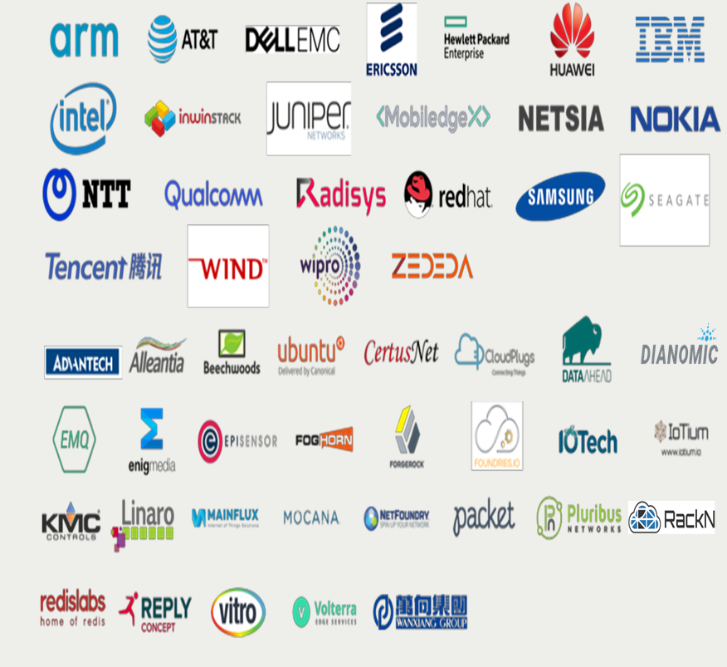
A Global Partner Ecosystem

Slide 17
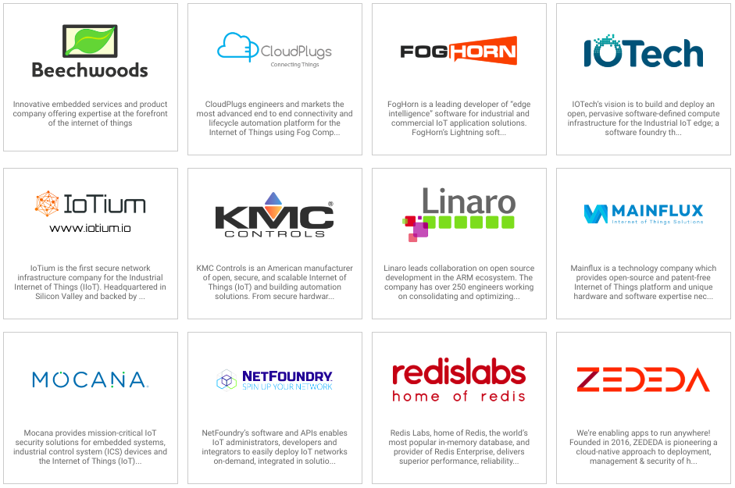
Complementary Product & Service Offerings

Slide 18
Announcing EdgeX Edinburgh V1 Release
EdgeX is the World’s first ecosystem enabled Open Platform for the IOT Edge
The Edinburgh v1.0 release represents a significant milestone in EdgeX development in that it is the first major release
Key Milestones
Stability - this is version 1.0 GA and, as such, the first release under the EdgeX long-term support, release and version strategy
Improved and added SDKs for vendor agnostic north and southbound connectivity plus many standard connectors
Significant new features including binary support, database “swapability”, improved APIs to help facilitate management/monitoring capability
Huge support from Global partner ecosystem offering a range of complementary products and services

Slide 19
Edinburgh Release Key Features
Support for Redis as well as MongoDB for all database using services (easier to replace the persistence stores)
Addition of application services and accompanying application functions SDK (will eventually replace the current EdgeX export services; more efficient and scalable)
Enhancement of the system management facilities (track and report on service CPU usage and metrics as well as track the operational status of each EdgeX service)
Ability to trace sensor data from the sensor to export while also supporting better debugging and performance metrics tracking
Support for the ingestion, use and export of binary data in CBOR format
Additions of unit and black box testing over the entire platform as well as the inclusion of automated security feature testing
Construction of a new performance framework
New and improved device service SDKs in Go and C; additional device services to connect more sensors and devices.
Improvements and cleanup around configuration bootstrapping, scheduler service, device profiles, API gateway and security secret store
Improvements to on-boarding EdgeX users
Upgrades to the security infrastructure

Slide 20
EdegX Security
Edinburgh Release
API Gateway – to protect unauthorized access to EdgeX APIs
Security Store – to protect secrets used by EdgeX services (tokens, username/passwords, certificates, etc.)
Security Issue Response – a process for reporting, triaging and addressing security issues
Coming soon
PKI infrastructure to generate the tokens and keys used by security services
Improved organization / isolation of the security store secrets
technology to ensure services running in EdgeX are those expected (and authorized).
A secure storage abstraction layer with a software implementation allowing platform providers to build hardware root of trust implementations that can be used by EdgeX
A renewed/refreshed threat assessment.

Slide 21
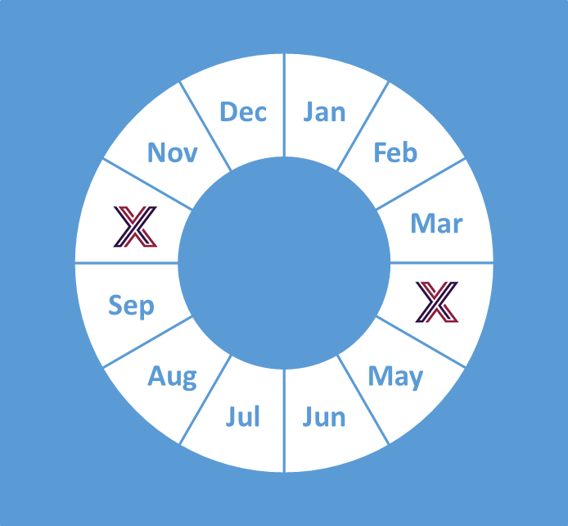
A Brief EdgeX History
Chartered by Dell IoT marketing in July 2015
A Dell Client CTO incubation project (Project Fuse)
Designed to meet interoperable and connectivity concerns at the IoT edge
Started with over 125,000 lines of Dell code
Entered into open source through the Linux Foundation on April 24, 2017
Started with nearly 50 founding member organizations; today we have more than 75 with over 100 contributors to the project
Release Cadence: 2 formal releases a year
Barcelona – Oct 2017
California – Jun 2018
Delhi – Oct 2018
Edinburgh – June 2019 – Version 1
Fuji – Oct 2019
Geneva – April 2020
Hanoi – Oct 2020

Slide 22
EdgeX Now Part of LF Edge (Jan 2019)
The Linux Foundation Launches New LF Edge to Establish a Unified Open Source Framework for the Edge
More than 60 global founding members across enterprise, IoT, telecom and cloud collaborate on open source framework for edge computing and future of IoT
SAN FRANCISCO, January 24, 2019 – The Linux Foundation, the nonprofit organization enabling mass innovation through open source, today announced the launch of LF Edge, an umbrella organization to establish an open, interoperable framework for edge computing independent of hardware, silicon, cloud, or operating system. LF Edge is initially comprised of five projects that will support emerging edge applications in the area of non-traditional video and connected things that require lower latency, faster processing and mobility.
LF Edge includes Akaino Edge Stack, EdgeX Foundry, and Open Glossary of Edge Computing, formerly stand-alone projects at The Linux Foundation. The initiative also includes a new project contributed by Samsung Electronics, which will create a hub for real-time data collected through smart home devices, and another project from ZEDEDA, which is contributing a new agnostic standard edge architecture.

Slide 23
Use Cases
July 2019

Slide 24
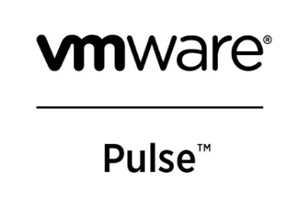


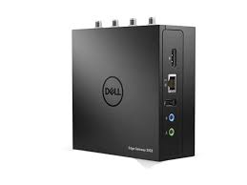


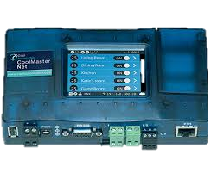
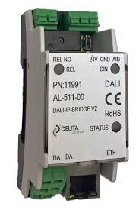
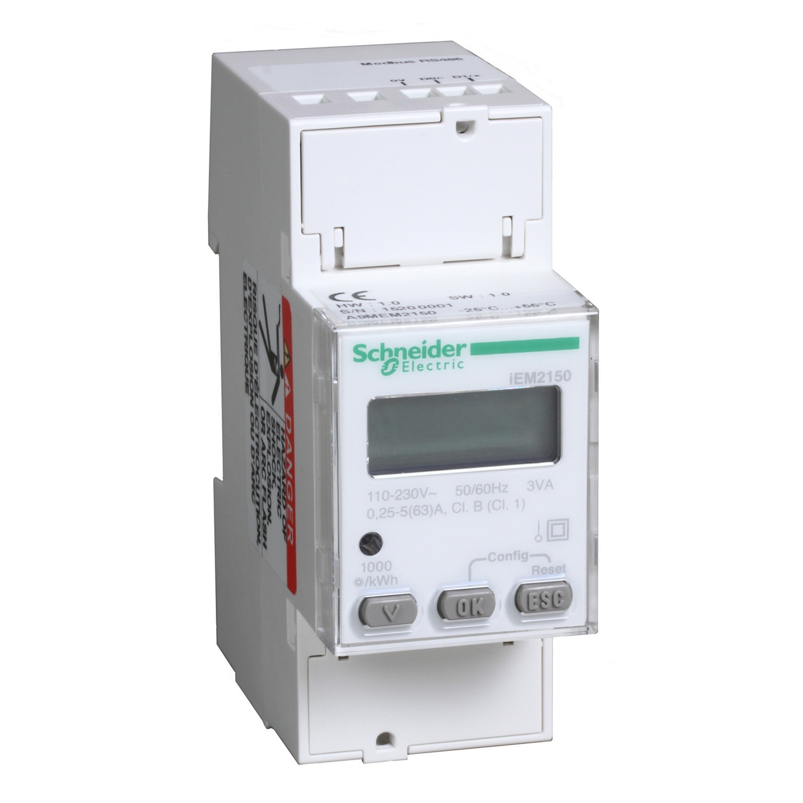
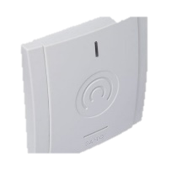
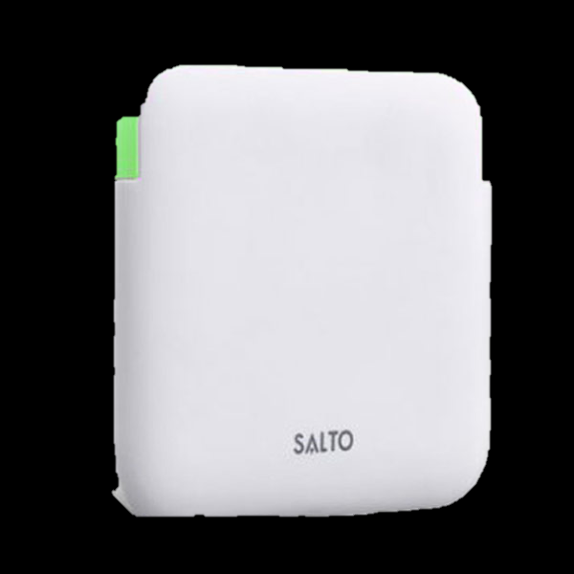

EdgeX in Buildings Automation
Cloud Vendors
Storage
Big Data Analytics
Dashboard
Project IRIS
Cloud
Systems Management
Security
Data /
control
Edge
Data Collection & Aggregation
Edge Analytics
Edge Control
Cloud Integration
Dell 3000 Gateway Series
Data /
control
Data
Data /
control
Data
Data
HVAC Controller
Environment Sensors
Lighting Controllers
Energy
Monitor
Key Reader
Access Control
Climate control
Lighting control
Energy Management
Occupancy tracking

Slide 25

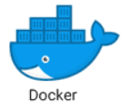
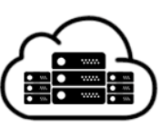


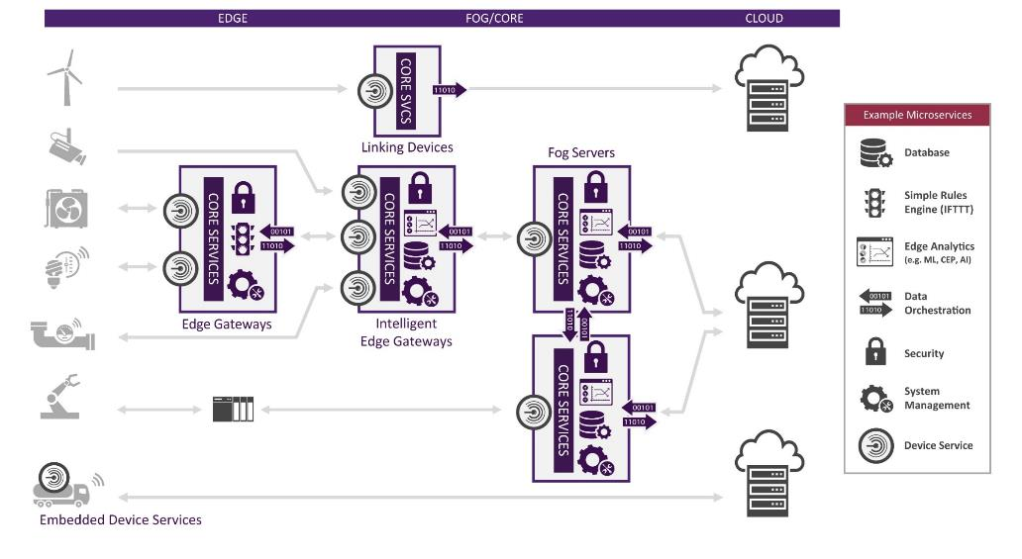
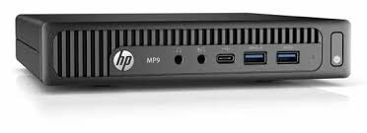

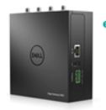
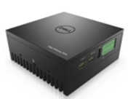

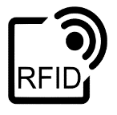




EdgeX in Commerce – Open Retail Initiative
Edge IoT Publisher
Containerized
Apps
Publish
Apps
Edge IoT Portal (Public/Private)
Manage Apps On Premise
Applications
IoT Edge Platform
IoT Edge Platform
People Counting
Line Estimation
Shift Management
Dell 3000 and 5000 Series
Edge Gateways
Stock Control
HP MP9
Point of Sales
Lighting Control
Digital Camera
RFID
Card Reader
HVAC
Temperature
Lighting Controller
HVAC Control

Slide 26











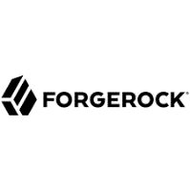
EdgeX in Process Control
SCADA/Cloud
Open Edge IoT Platform
Core Platform
Export Service
Integration with SCDA or Cloud endpoints via OPC UA
or MQTT
Supporting Services
ZeroMQ
Pub/Sub
Analytics
Logging
Core Data Service
Storage
Scheduling
Device Service
Export directly in Core Data
Soft PLC
System Management Agent
SMA
Real-time Subsystem
Export Service
Pluggable (optional) System Management
(e.g. VmWare Pusle, Pixeom, Kubernetes/K3S)
Real-time Analytics & Control (e.g. PID)
Real-time Core
Real-time Database
(e.g. Chronicle)
Device Service
Pluggable Security
Protocols
(e.g. Modbus)
Containerized Workloads
(e.g. Kata, Docker)
OT data ingestion via Device Service deployed on Core Platform or RT Subsystem
Pluggable (optional) Security
e.g. RSA Iris, FORGEROCK, MOCANA
Linux VM
RT Linux VM
Zephry VM
Other…
Hypervisor (Optional) e.g. ACRN
Hardware e.g. Axiomek rBOX510

Slide 27
EdgeX Project Organization

Slide 28
Key Project Links
Access the code:
https://github.com/edgexfoundry
Access the technical documentation:
https://docs.edgexfoundry.org/
Access technical video tutorials:
https://wiki.edgexfoundry.org/display/FA/EdgeX+Tech+Talks
EdgeX Blog:
https://www.edgexfoundry.org/news/blog/
Join an email distribution:
https://lists.edgexfoundry.org/mailman/listinfo
Join the Slack Channels:
https://slack.edgexfoundry.org/
Become a project member:
https://www.edgexfoundry.org/about/members/join/
LinkedIn:
https://www.linkedin.com/company/edgexfoundry/
Twitter:
https://twitter.com/EdgeXFoundry
Youtube:
https://www.youtube.com/edgexfoundry

Slide 29
Thank You

